Slide 2
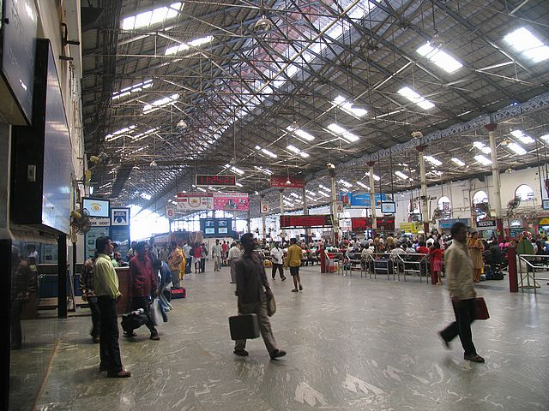
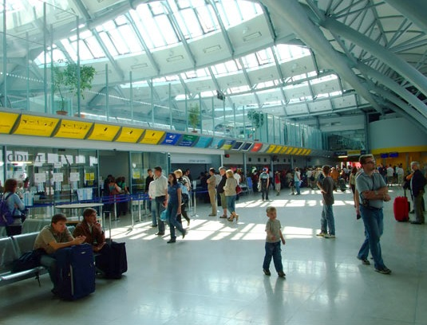
Left luggage detection
Introduction
Detection of abandoned items in public places:
Airports
Train station
Issues:
Shadows
Occlusions
Illumination changes
Clutter

Slide 3
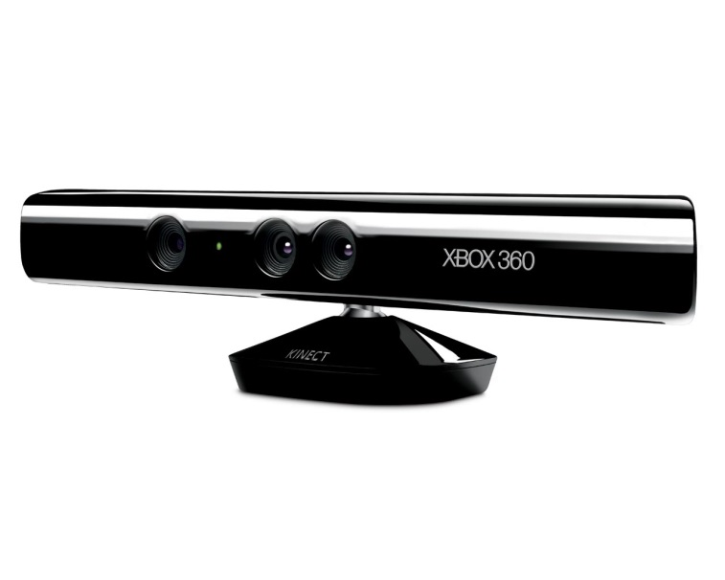
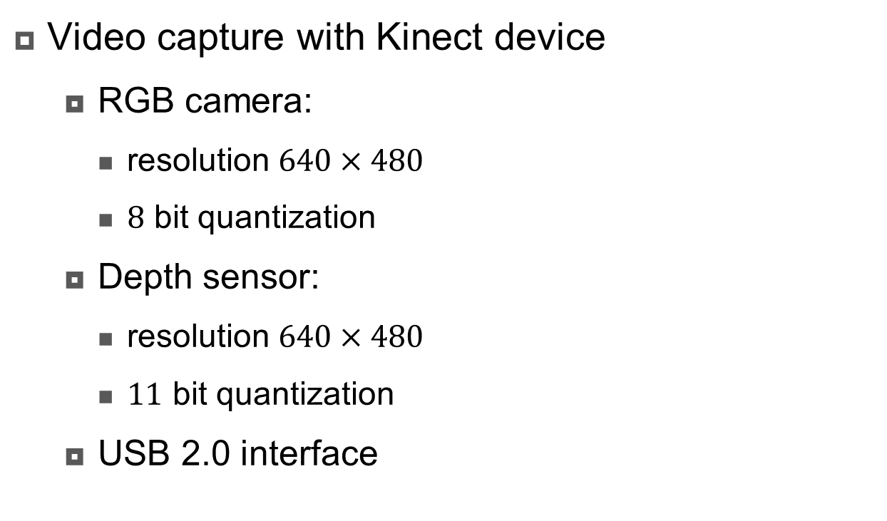
Kinect
Introduction
Video capture with Kinect device
RGB camera:
resolution $640×480$
$8$ bit quantization
Depth sensor:
resolution $640×480$
$11$ bit quantization
USB 2.0 interface

Slide 4
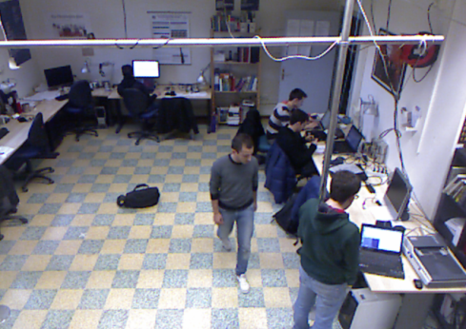
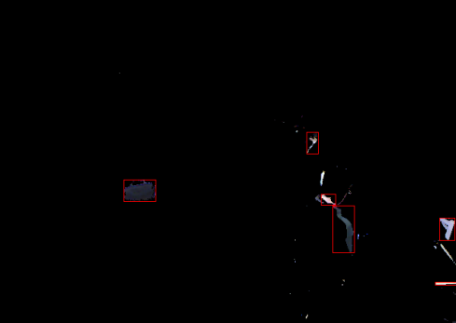
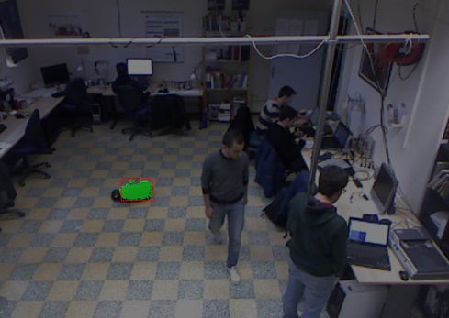

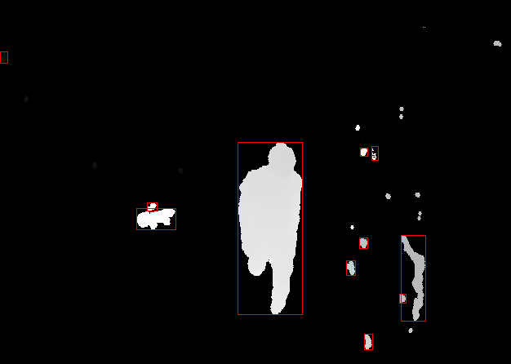
Pipeline
Approach
RGB and depth video are analyzed independently

Slide 5

Technologies
Development
OpenKinect
Open source library
Multiplatform

Slide 6

Thanks
Thanks

